Slide 1
JIRA
Chetan patil

Slide 2
What is jira?
JIRA is an Incident Management Tool used for Project Management, Bug Tracking, Issue Tracking and Workflow
Developed by Atlassian.

Slide 3
Why Jira is used for?
Jira Software used to help teams of all types manage work.
Jira was designed as a bug and issue tracker.
Jira is awork management tool for all kinds of use cases, from requirements and test case management to agile software development.

Slide 4
Basic concepts of JIRA
Issues
Projects
Components
Workflow

Slide 5
JIRA project
A Jira project is a collection of issues
Every project is issues belongs to a Project
Each project is identified by a Name
Project Key is appended to each issue associated with project
Example:
->Name of project : Social media
->Project Key : SM
->Issue : SM_24 Add a new friend

Slide 6
Issue
Issue is the building block of the project
Depending on how your organization is using JIRA,an issuecould represent:
a software bug
a project task
a helpdesk ticket
a product improvement
a leave request from client

Slide 7
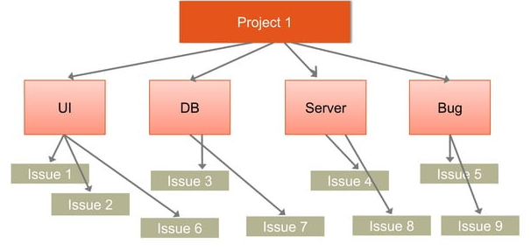
Component
Components are sub-sections of a project
Components are used to group issues within a project to smaller parts

Slide 8
Workflow
A Jira workflow is the set of statuses and transitions that an issue goes through during its lifecycle
Workflows typically represent business processes.
Jira comes with default workflow and it can be customized to fit your organization.

Slide 9
THANK YOU!

